Slide 1


Concentrix presentation for Abu Dhabi Commercial Bank
14th February 2021

Slide 2



Concentrix
Agenda
JAX and CR
Introductions and Opening
CCE
Automated Customer’s Email Responses
Visualization of Overall flow
Appendixes
Features | Implementation Plan | Support
Support and maintenance
Solution components
Licensing Model & Pricing
Notes:
Presenter (s) – Ewa/Lukasz

Slide 3
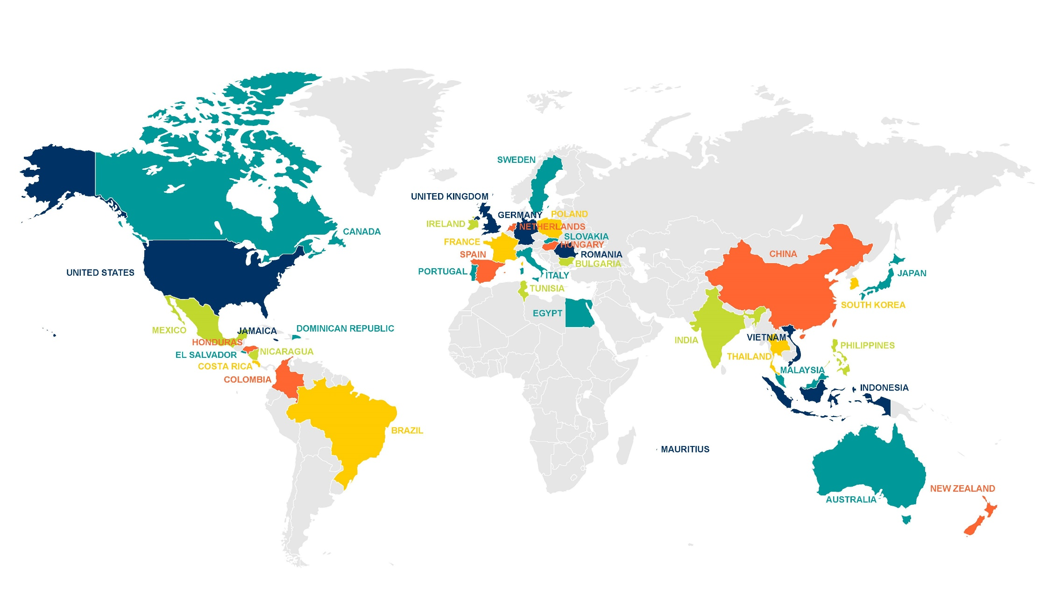
Concentrix Introduction
Business is borderless. Being global truly matters.
Our geographic footprint meets the needs of global clients. Global consistency with local intimacy.
40+
6
70+
Countries
Continents
Languages
Notes:
We have one of the most complete, robust footprints in the industry.
Across 40 countries and 6 continents; over 70 languages.
We deliver global consistency with local intimacy.
.

Slide 4




Who We Are Today
You already count on
Concentrix every day
40+
12+
35+
Years of Market and Industry Experience
Average Years of Global Client Tenure
Years of Longest Client Partnership
We stand behind the iconic brands you trust
250,000
$4.7B
650+
70
Employees
Revenue
Clients
Languages
Media and Communications
Automotive
Company
Technology
Company
Leading Cloud
Company
Telecom
Company
Everest Group recognizes us as a
Leader for CXM Services
228
40+
6
9.8B
Locations
Countries
Continents
Contacts
Notes:
TIM

Slide 5

Cognitive Customer Engagement (CCE)

Slide 6

Cognitive Customer Engagement
CCE is an extensible software platform that imparts cognitive capabilities and intelligent automation to customer interaction and client’s business processes using multiple communication channels by seamlessly integrating client’s front and back-office systems and business workflow.

Slide 7
Cognitive Customer Engagement
Secured & Compliance Deployment Model
(Orchestrate Cloud & On-Premise )
BOT Ecosystem
(Harmony of Voice, Chat, Email, Knowledge and Task Bot)
Omni Channel Touchpoint
(Online, Offline, Instant & Social Messaging)
Natural Language Understanding
(Intent , Entity and Tone Identification)
AI & machine Learning
(Pattern Recognition & Deep Learning)
Integration with Business Applications
(Enterprise Systems, Email & Workflow Solutions)
Business Analytics & Customer Insights
(Social Listening, Empathy Detection, Behavior Analysis)
Vendor Agnostic
(Amazon, KORE AI, Google, IBM Watson, UiPath, etc.,)

Slide 8
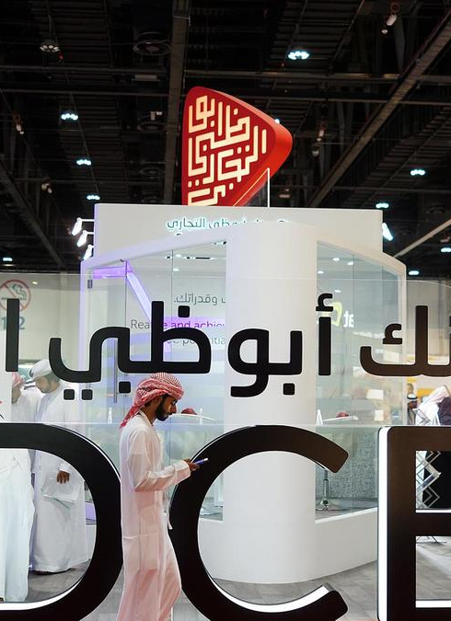
ADCB - Automated Customer’s Email Responses
Via Concentrix Email Bot

Slide 9






What is an Email Bot
Concentrix Email bot is an
AI powered Software that can,
1
5
3
Read customer emails
(Email Subject & Body)
Categorize
Agent reviews bot generated response
2
4
Understand context
Generate draft response
Powered by AI
Exclusive NLP
E2E Email Automation
Human & Bot Collaboration

Slide 10

Solution highlights
Key Features
In-built Bot Platform & Natural Language Capability
Integrated & Non-Integrated deployment variants
NLP driven responses & Template Customization
Attended & Unattended Automation
360 º - Insights that are actionable & unbiased
Cloud Infra Managed by ADCB (full Email Bot application Support by Concentrix)
Multi-Lingual Capabilities
No per seat or per agent fees
Multi-Intent Support
Enterprise Apps Integration
Sentiment Analysis
360º Dashboard
Role based Access
Skill-based routing
In-house
Training module
Agent Effort Score
SPAM Identification

Slide 11



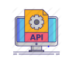







Concentrix Email Bot
Enterprise Ready Email Automation Engine
Attended
3
4
5
6
7
1
2
3
Customer Email
Intent Detection
PII Masked / Encrypted
Sentiment Analysis
Skill based Routing
Powerful Integrations
Agent Reviews & “SEND”
IMPROVED AHT
LESSER AGENT EFFORT
BOOST BUSINESS REVENUE
IMPROVED NPS / CSAT
HIGHLY SCALABLE & SECURE
High
Configurability
Template
customization
ROI / Outcome focused
Quality
Assurance

Slide 12




Concentrix Email Bot
Enterprise Ready Email Automation Engine
Unattended (Auto Response)
3
4
5
6
7
1
2
3
Customer Email
Intent Detection
PII Masked / Encrypted
Sentiment Analysis
Bot prepares Draft response
API based Integrations
(simple use cases say Acc Balance, Loan Due date
Auto “SEND”
Un Attended Automation achieved via:
Similarity Score /
Agent Effort
Automated Training of Intents/Drivers delivering High Confidence scores
Machine learning algorithms delivering auto response with close proximity results(Supervised learning)

Slide 13
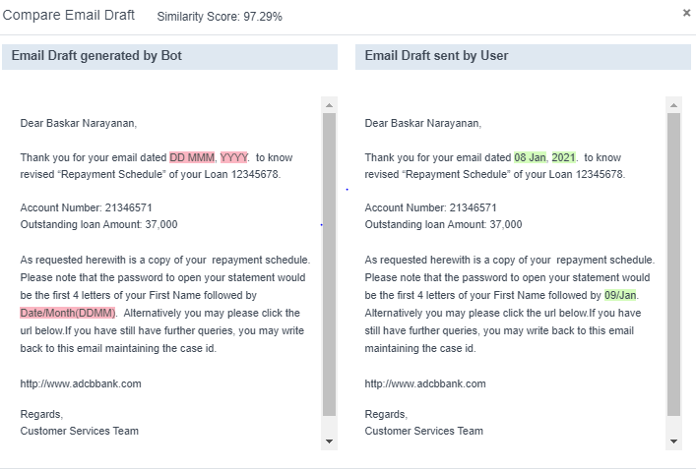
Similarity Score / Agent Effort
Intent: Repayment Schedule

Slide 14
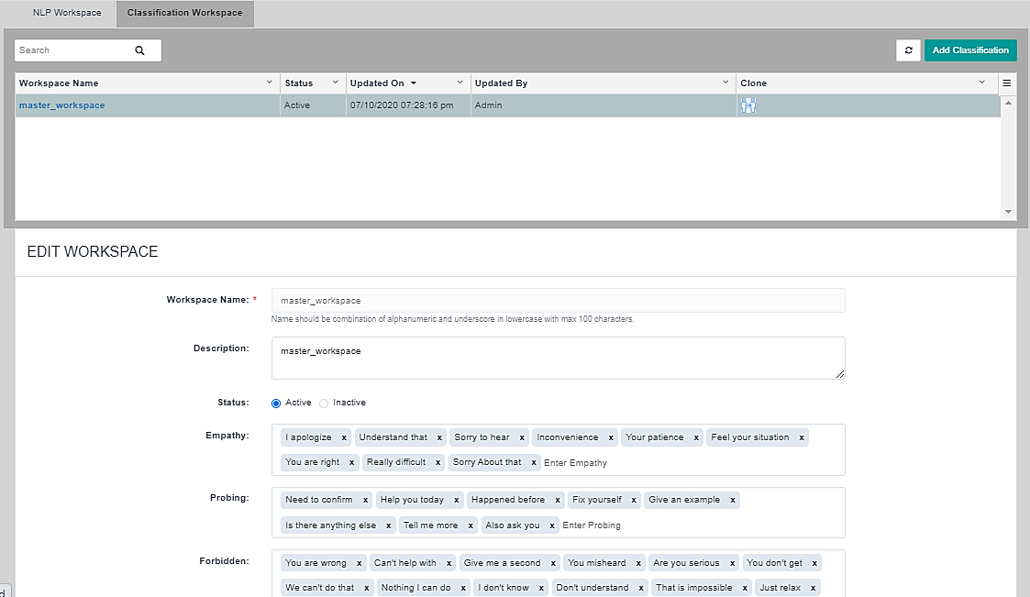
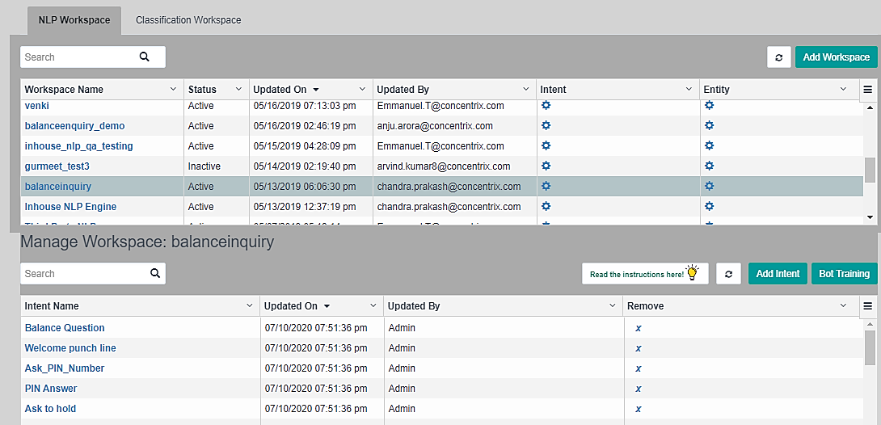
Email Bot Training Module

Slide 15
Visualization of Overall flow

Slide 16





Smarter Email BOT Assistance
Attended Automation (Human in the loop)
Sample Use Case : Apply for New Credit Card: Loyalty program of renowned UAE Airways
Incoming Customer Email via Web Form
Input Parameters :
Salary :
Passport No:
Emirates Id
Employer Name:
Apply for new product -Credit card – Client loyalty program,)
Dear Mohammed, Thank you for your interest in ADCB.
We regret to inform you that you are not eligible for a credit card from us at the moment as your salary is below the minimum requirement.
Regards,
Customer Service Team
Hi, I am interested in applying for Etihad guest credit card. What is the eligibility criteria and process? Am I eligible?
Regards
Mohammed
Existing Email Exchange Server Integration
Look up to Credit Score related DB
As-Is Email Platform Integration
Intent understanding
Understand
Context of Email
Data lookup ADCB
(CRM/ Banking Applications/
Credit Bureau)
AI Engine Preparing Response for Auto Send

Slide 17
Appendix H – Functional Requirements
Appendix K – Technical Requirements
Appendix J – Security, Business Continuity

Slide 18
Appendix H - Functional Requirements

Slide 19
Appendix K - Technical Requirements

Slide 20
Appendix J - Security Requirements
Security Requirements

Slide 21
Appendix nn – Business Continuity Requirements

Slide 22
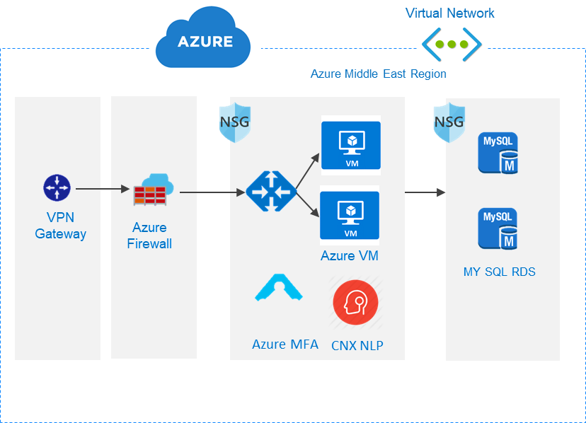




DC – DR Architecture Recommendation to ADCB managed cloud infra
Zone 1
Concentrix Network
Both DC and DR infrastructure planned to be in High Availability mode
If needed, DR can be reduced to single instance rather than HA from an Application standpoint
Dev/UAT environments planned only for DC
Infrastructure Level switch between DC and DR will be managed by ADCB
ADCB Network
ADCB Data Centre
Gateway
VPN Gateway
Zone 2
CNX IT team
Application Users

Slide 23
DC – DR Architecture - Specifications
Primary Data Center
S. No | Server Role | Server Type | Purpose | Operating System | VCPU Cores | VRAM in GB | Hard Disc Space In GB | Quantity | Additional Software
1 | Application & web services | Virtual | Production | Cent OS | 8 | 16 | 500 | 2 | Domain names required cce.adcb.com Apache, Tomcat 8.5, Memcached, Java 8 and Nginx
2 | Network Load Balancer | Virtual | Production | Cent OS | 2 | 8 | 100 | 1
3 | Data base Cluster | Virtual | Production | Cent OS | 8 | 32 | 500 | 2 | MY SQL Enterprise Edition V5.7
4 | Application & web services | Virtual | UAT | Cent OS | 8 | 16 | 500 | 2 | Domain names required cceuat.adcb.com Apache, Tomcat 8.5, Memcached, Java 8 and Nginx
5 | Data base Cluster | Virtual | UAT | Cent OS | 8 | 16 | 500 | 1 | MY SQL Community Edition V5.7
Secondary Data Center
S. No | Server Role | Server Type | Purpose | Operating System | VCPU Cores | VRAM in GB | Hard Disc Space In GB | Quantity | Additional Software
1 | Application & web services | Virtual | Production | Cent OS | 8 | 16 | 500 | 2 | Domain names required cce.adcb.com Apache, Tomcat 8.5, Memcached, Java 8 and Nginx
2 | Network Load Balancer | Virtual | Production | Cent OS | 2 | 8 | 100 | 1
3 | Data base Cluster | Virtual | Production | Cent OS | 8 | 32 | 500 | 2 | MY SQL Enterprise Edition V5.7

Slide 24
Features | Implementation Plan | Support

Slide 25
Unique Features to be Delivered in Email Bot for ADCB
Sl. No | Major Features
1 | Multiple intent-based responses
2 | Template creation based on intent, sentiment and entity
3 | EWS/graph Api integration
4 | Auto response based on confidence score
5 | Response based on Intent and sentiment
6 | Spam filtering
7 | Email prioritization / assignment agent (Skill/Keyboard/VIP)
8 | BI reports and current dashboard
9 | Prioritization and Segmentation of emails and routing based in Sentiment Analysis
10 | In house NLP engine
Sl. No | Major Features
11 | Admin UI for Intent / Entity creation
12 | Admin UI for Intent training
13 | Multilingual support (BOT only) using Google translate
14 | Spell and Grammar check
15 | Trail Email based analysis and generate intelligent response
16 | BOT training – 43 Call Drivers as specified in RFP
17 | Client system integration
18 | Mandatory reports and dashboard
19 | ADCB specific security requirements(encryption keys at rest)
20 | Ability to identify new categories and configure new response
Features to be covered as Product enhancement/forthcoming releases.
Sl. No | Major Features
1 | Notification on the usage of profanity language by the agent
2 | Configuring TAT based on certain criteria and escalation model
3 | Feedback loop and approval workflow for unidentified mails
4 | Any other Reports and Dashboard
5 | Identification of the last website / mobile app page used prior to writing the mail

Slide 26
Delivery Timelines & Key Milestones
14
1 | 2 | 3 | 4 | 5 | 6 | 7 | 8 | 9 | 10 | 11 | 12 | 13
Requirement Elicitation
Week 1-3
Week 3-10
Development
Week 8-10
Testing
Week 11-12
UAT
Week 13-14
Production
Go-Live
Go-Live
From Week 15
Hypercare (1 month)
followed by BAU support

Slide 27
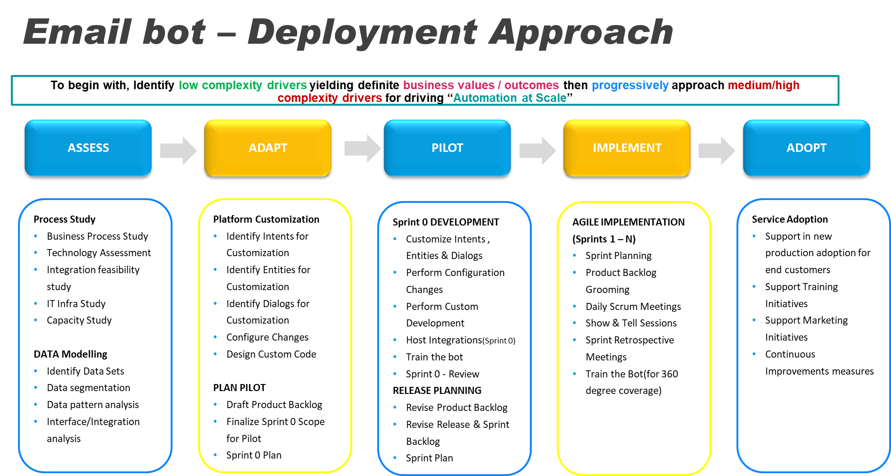

Slide 28
Change Management Process
 | Change Process | Owner | Task
1 | Submit RFC | Change Owner / Implementer | All change record fields are to be filled out in detail
2 | Technical Review | Change leaders within network/client network | Review to ensure change details are technically robust and accurate Approves change (as the network/voice/server\Application vertical team change SPOC/Leader)
3 | CAB Review | Change Approval Board (CAB) | Overall review and Line up Changes with ADCB & Concentrix Change team for approval Ensuring impacted teams and ADCB have approved; full awareness/communications to all
4 | Global Review | Global CAB | Global review and final approval of change with additional level of review with Leadership for business-critical changes
5 | Change Execution | Change Owner / Implementer | Change owner executes change, updates the change record with results, closes the change record All other changes: Change owner joins the 24/7 change bridge and starts execution of change If Business critical Change, help desks sends maintenance/change alert email at start of change
6 | Closure | Help Desk | Change owner provides change status at end of change Help Desk updates change record and change log If global change, help desk sends maintenance/change alert email with change results
The above applies to Non – Standard , Normal changes .. For Expedited, Emergency changes (depending upon criticality) the ECAB shall quickly pursue & execute changes

Slide 29

360 º Dashboards / Reports
No. of Emails handled by Email (across intents/drivers)
No. of Emails Received
No. of Emails Identified
No. of Emails Replied
No. of Emails Edited
No. of Emails Unread
No. of Emails Intent Match
No. of unidentified emails (Exceptions)
Non-Actionable Emails
Sentiment Data
Over-all TAT
Agent TAT
Reply & Edit %
Intent wise Status
Transaction Report
Trend Report
Resource Utilization
Reply/Reply Pending Status

Slide 30
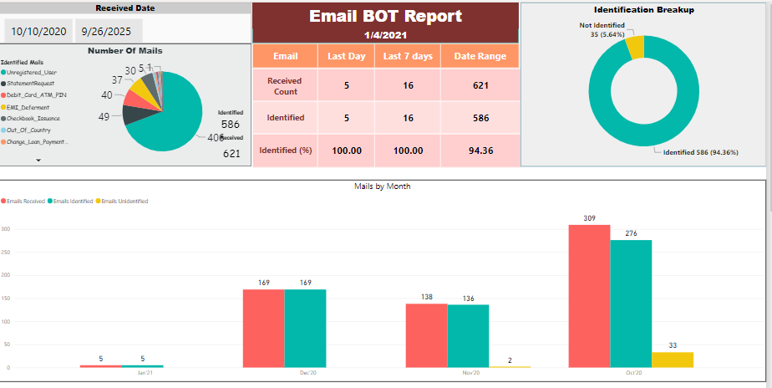
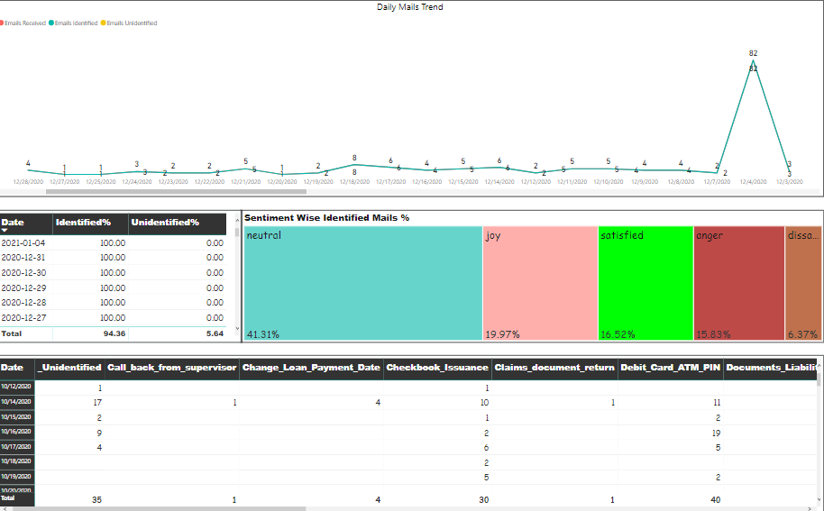
Email bot 360 º
Insights that are Actionable & Unbiased

Slide 31
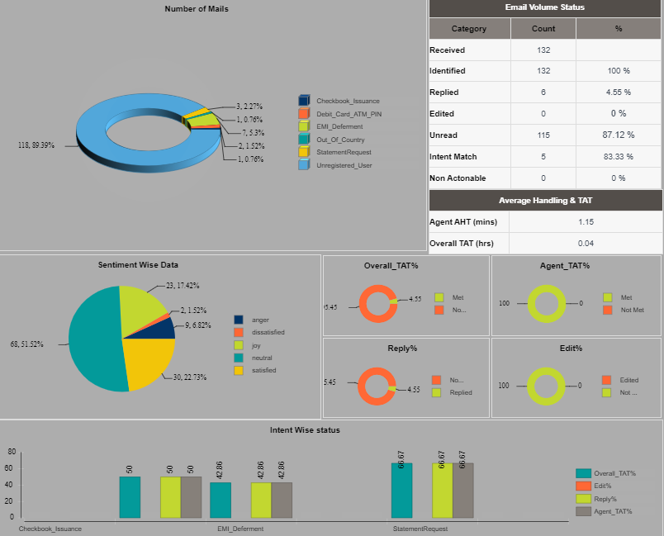
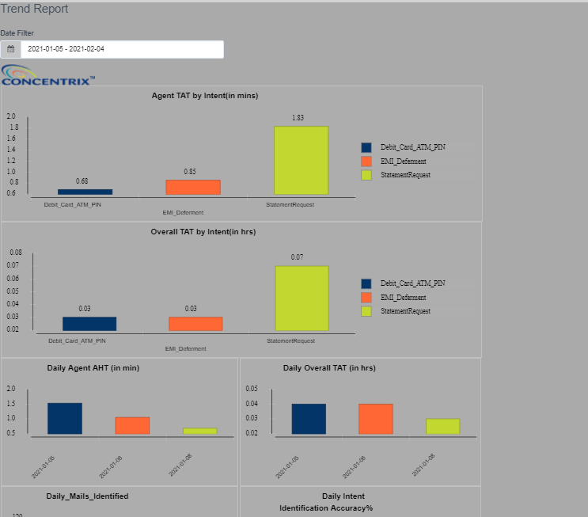
Email bot 360 º
Insights that are Actionable & Unbiased

Slide 32
Support & Maintenance

Slide 33
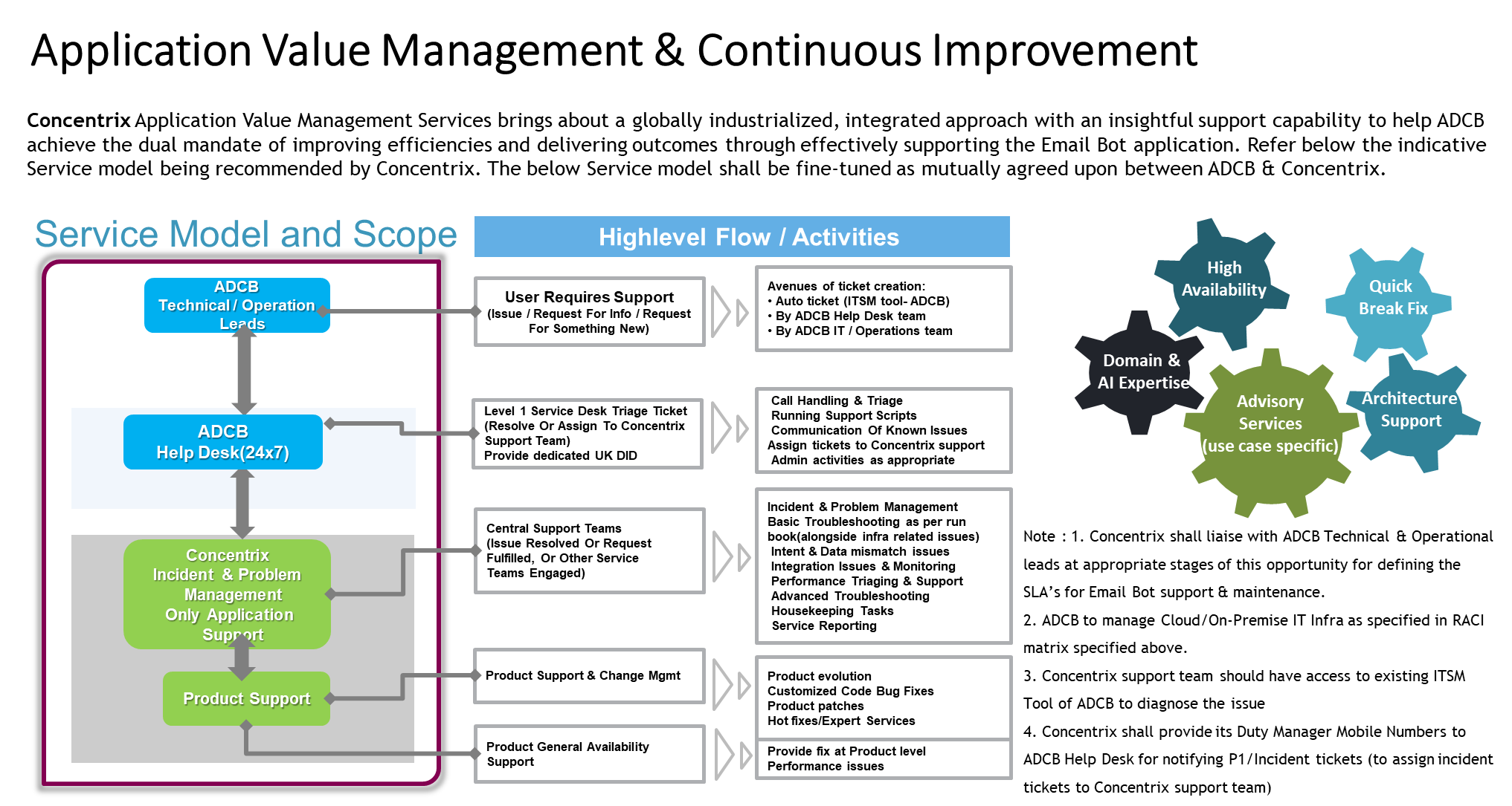

Slide 34
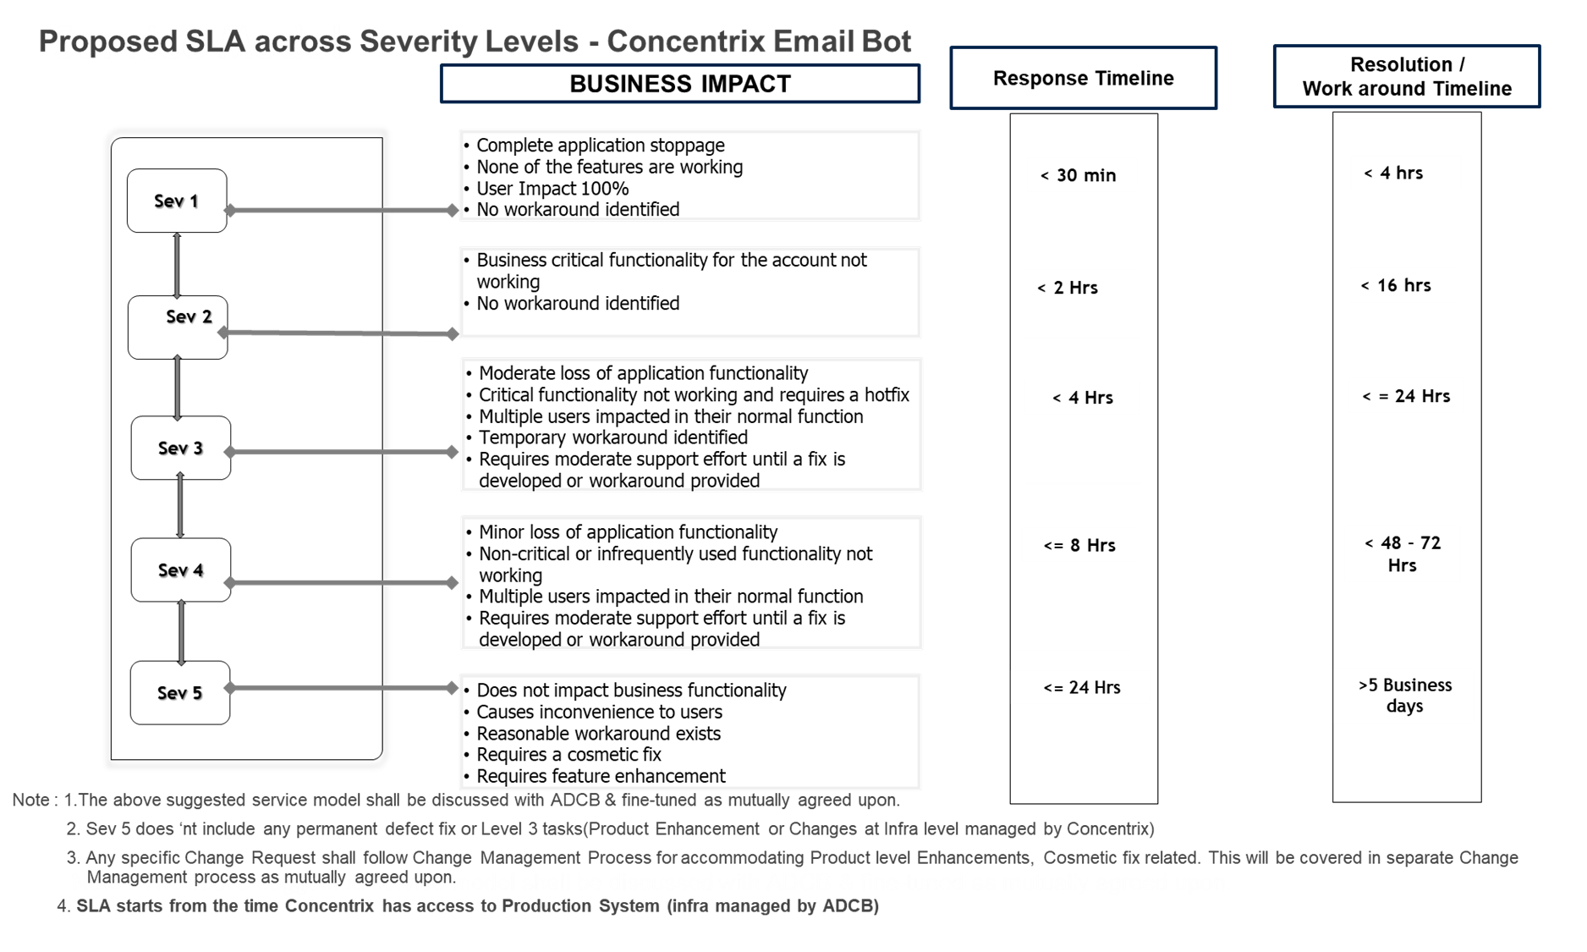

Slide 35

Roles & Responsibility Matrix
Solution Call Outs(Cloud Hosting)
Development Pre-requisites

Slide 36
Roles and Responsibility Matrix – Who Does What
S. No | Solution Component | ADCB Scope | Concentrix Scope
1 | Provision and manage base infrastructure including Servers, Operating system and Database for CNX Email BOT hosting, as per CNX specified configuration for both primary and secondary instances | ☑
2 | Provide access to this environment to the CNX support team for one time deployment as well as ongoing support thru VPN over internet with necessary user level permissions/restrictions | ☑
3 | Deploy ADCB’s security policies | ☑
4 | Infrastructure (hardware, OS, DB) level SLAs AT Primary and DR Sites | ☑
5 | Application installation (Remote) |  | ☑
6 | Ongoing Application maintenance and support |  | ☑
7 | IT Helpdesk, Incident Management and required ITSM tool | ☑
8 | Access to ADCB’s ITSM tool for CNX support team as needed | ☑
9 | Application-level SLAs |  | ☑
10 | Switching between DC and DR – Infrastructure layer | ☑
11 | Switching between DC and DR – Application layer |  | ☑
12 | Email BOT integration with ADCB applications | ☑ | ☑

Slide 37
Key Solution callouts for ADCB managed Azure Tenant based hosting
 | ADCB Azure Tennent ( Recommended )
Deployment | Infrastructure Setup will be fully compliant and integrated with ADCB Core Infrastructure, Which will ensure high degree of compliance with minimum cost. Risk/Mitigation : The control comes at the expense of flexibility to operate in the time of crisis, Where availability of system is constrained. Delay needs to high lighted as potential risk. All SLA (1-Pp5) count start, once CNX gets access to the EmailBOT system for diagnostics.
Control | Enterprises enjoy complete control over their systems and maintain 100 percent control of management. Concentrix Support team gets any production access over a monitored remote terminal. Risk/Mitigation : Concentrix Support team access needs to be planned very carefully so that access and associated logs are optimally captured
Security & Compliance | Security and Compliance will not be a challenge as tenant is customer managed. Also, given the tenant is hosted in UAE, regulatory compliance will be fully met. Risk/Mitigation : Remote VPN access needs to secured and machine locked for maximum protection
Support | Help Desk , Ticketing , Cloud Infra(including DB, Security, OS) will be managed by ADCB. Application level(Email Bot) Incident , Problem & Change Management will be managed by Service Provider. Risk/Mitigation : Potential communication delay should be addressed through Phone hotline with Application support team.
Cost | ADCB Tenant based hosting is a cost effective and secured model. Risk/Mitigation : The proposed support team is based out of India, with option of providing dedicated support in UAE for extra cost. If customer decides to go with local support or CNX hosted solution , the cost and accordingly price will significantly change

Slide 38
Email Bot – Build / Development Pre-requisites
Email Bot – Build / Development Pre-requisites
Activities | Pre-requisites (ADCB)
Discovery workshop | Discovery workshop covering As-Is Technology Landscape, as-is email workflows etc. Need participation of Customer IT and process SME.
Current State Assessment & Requirement Document | Access to current email templates/samples, Business processes and Stakeholders
Integration to Downstream systems – | Customer to provide necessary API’s of in-scope applications to interface with Concentrix CCE Email Bot
Process Maps | Process Diagram clearly explaining how the emails processed by BOT and Human are in synergy. Also, how the email ticketing works including there tracking
Key stake holders' participations at key stages during project development | Customer shall assign key stakeholders at various stages during project development for necessary consultation & sign-off
BOT Training & Fine tuning | Less effort we foresee from Customer. CNX would perform necessary bot training & fine-tuning of data for higher bot accuracy.

Slide 39
Licensing Model & Pricing

Slide 40
Licensing Model
# | Software Component/Module Name | Version | Number of Licenses Proposed | Licensing Model (Perpetual/Subscription)
1 | Concentrix CCE Email Bot | 3.2.1 | No per seat or per agent fees. Email Bot shall be deployed for in-scope business teams (with agents) | Perpetual

Slide 41
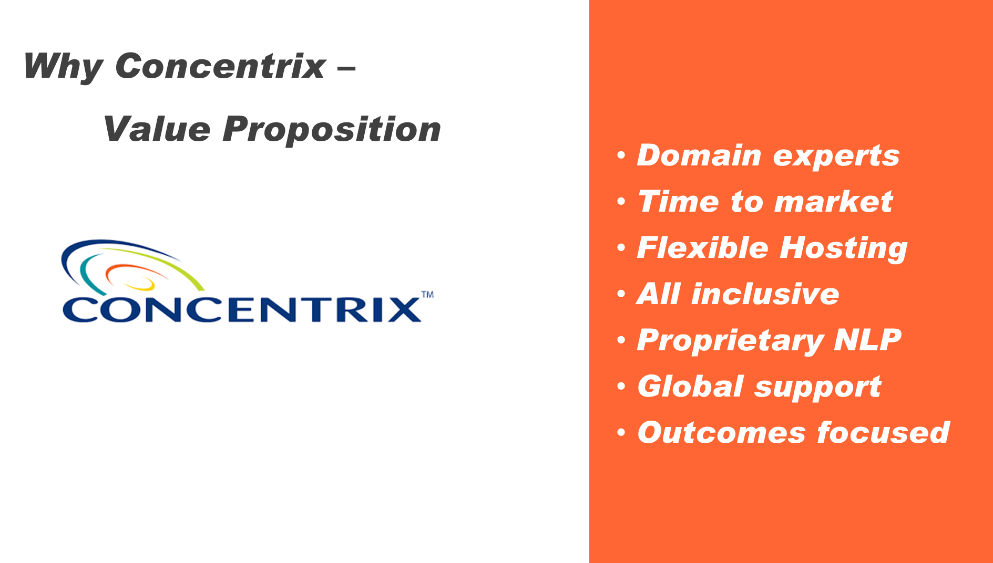

Slide 42
Thank you

